Slide 1

Text Segmentation in image using Autoencoder / GAN
Instructor :- Professor Aparajita Ojha
Team Name :- MindNet
Presented by:- Dhaval Taunk (2016081)
Mehul Gupta (2016154)
Rishabh Bajpai (2016207)

Slide 2
Problem Statement explained
The problem statement for the project aims at detecting text regions in an image by using either autoencoders or Generative adversarial Network. The dataset used for this project is MSRA-TD 500 and KAIST Text Scene Dataset

Slide 3
Details about the Dataset
The MSRA Text Detection 500 Database (MSRA-TD500) contains 500 natural images
Images are from indoor (office and mall) and outdoor (street) scenes using a pocket camera.
The indoor images are mainly signs, door plates and caution plates while the outdoor images are mostly guide boards and billboards in complex background.
The resolutions of the images vary from 1296x864 to 1920x1280.

Slide 4
Autoencoder
Autoencoder is an unsupervised artificial neural network that learns how to efficiently compress and encode data then learns how to reconstruct the data back from the reduced encoded representation to a representation that is as close to the original input as possible.
It has major 4 parts:
1- Encoder: 2-Bottleneck
3-Decoder 4-Reconstruction Loss

Slide 5
Generative Adversarial Networks
GANs involve training a generative model by framing the problem as a supervised learning problem with two sub-models:
Generator model that we train to generate new examples
Discriminator model that tries to classify examples as either real (from the domain) or fake (generated).
The two models are trained together in a zero-sum game, adversarial, until the discriminator model is fooled about half the time, meaning the generator model is generating plausible examples

Slide 6
Approaches Tried
UNet: It a type of autoencoder evolved quite recently producing encouraging results for image segmentation & classification.
Though, never been tried for text segmentation.
The approach followed by UNet is:classification on every pixel, so the input and output share the same size.
It got its name due to the “U” shape architecture that is symmetric and consists of two major parts — the left part:contracting path, constituted of convolutional process; the right part: expansive path, constituted by transposed 2d convolutional layers
As the results produced were not good enough, it was scrapped.

Slide 7
Training using MSRA-TD 500
We used MSRA-TD500 dataset as suggested. Different architectures were used while training.
The target image is formatted in 2 different ways and training was performed on both these datasets.
Image augmentation was also applied as size of dataset was very small (300 images for training and validation).
The results were not up to the mark using this dataset. Architecture that was used is shown in the next slide.

Slide 8



Training images sample
Training Image Target Image 1 Target Image 2
Fig. 1 Training image, and targets images are shown

Slide 9
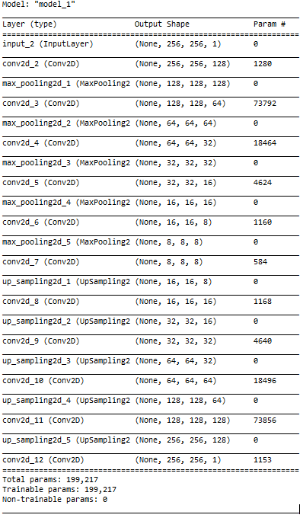
Architecture trained on MSRA-TD 500

Slide 10
Training on KAIST Text Scene Dataset (link)
After all the failed attempts on MSRA-TD 500 dataset. We decided to switch to some other dataset that will have sufficient number of images for training.
KAIST Text Scene Dataset contains 3000 images. This is a very good amount as compared to just 300 images of MSRA-TD 500.
The architecture and results are shown in the next few slides.

Slide 11
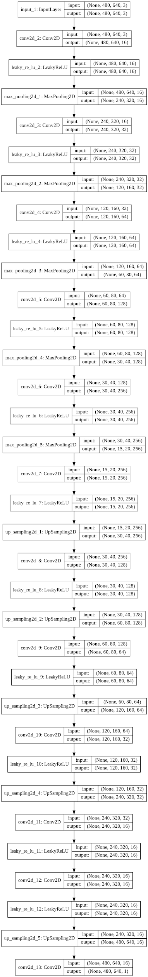
Network Architecture - trained on KAIST dataset

Slide 12
Network Architecture- trained on KAIST dataset
Total params: 1,377,073
Adam(lr=0.0001, beta_1=0.9, beta_2=0.999)

Slide 13
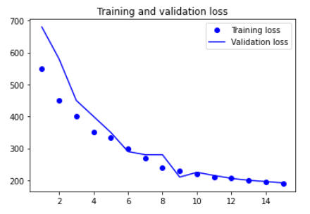
Training Plots
Fig. 2 Training and validation loss are shown (dots are for training loss and line is for validation loss)

Slide 14
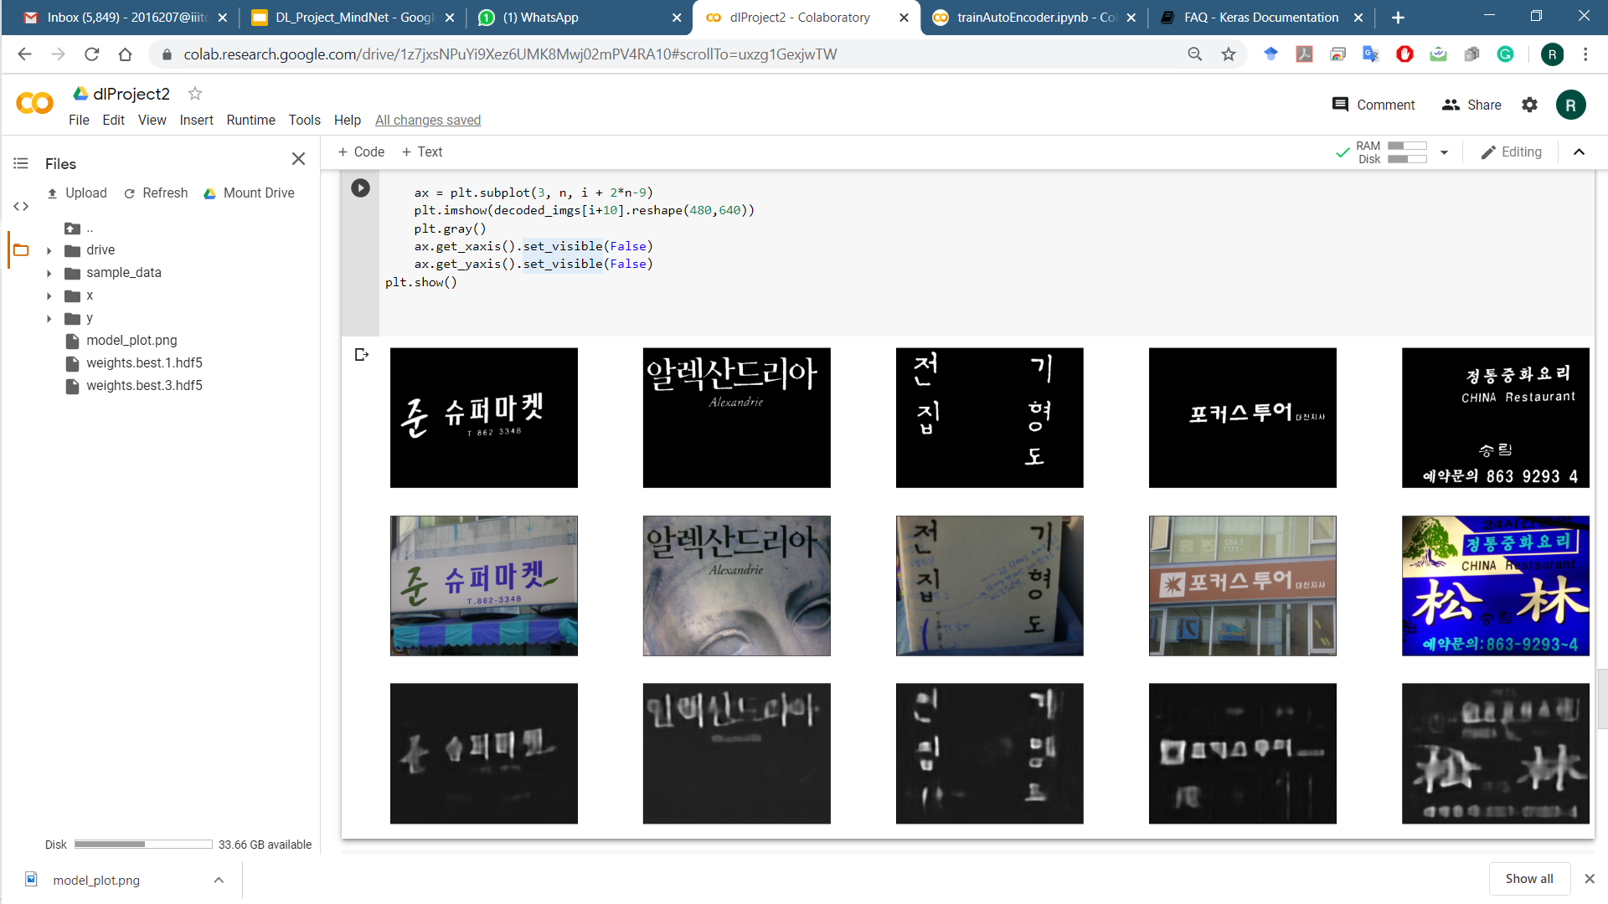
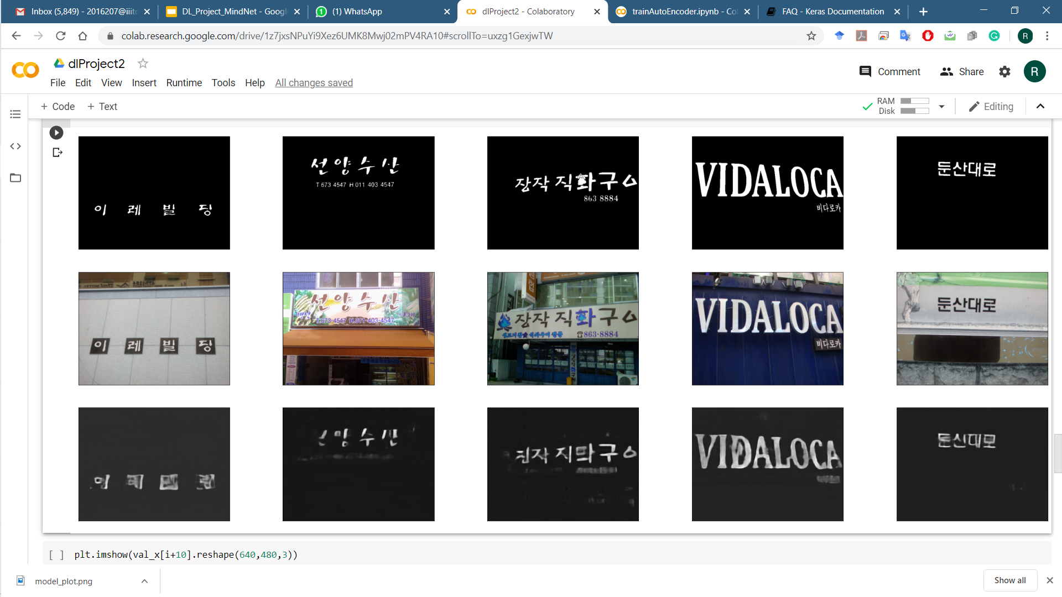
Results
After First 6 epochs

Slide 15
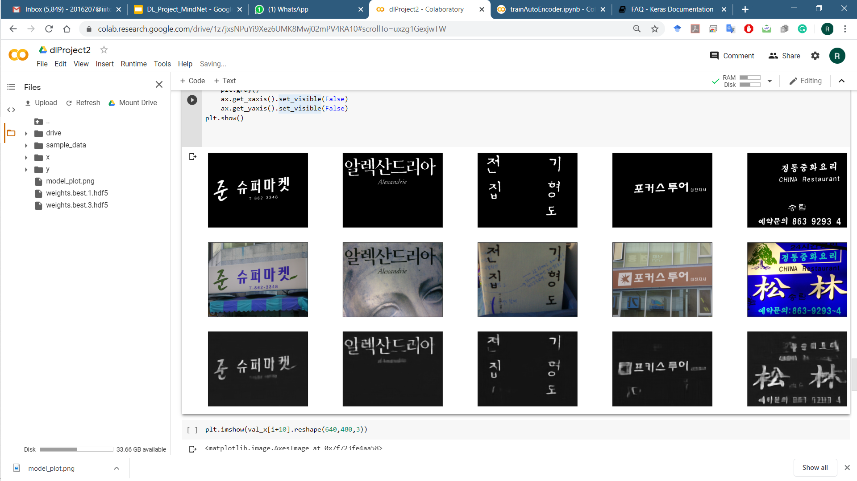
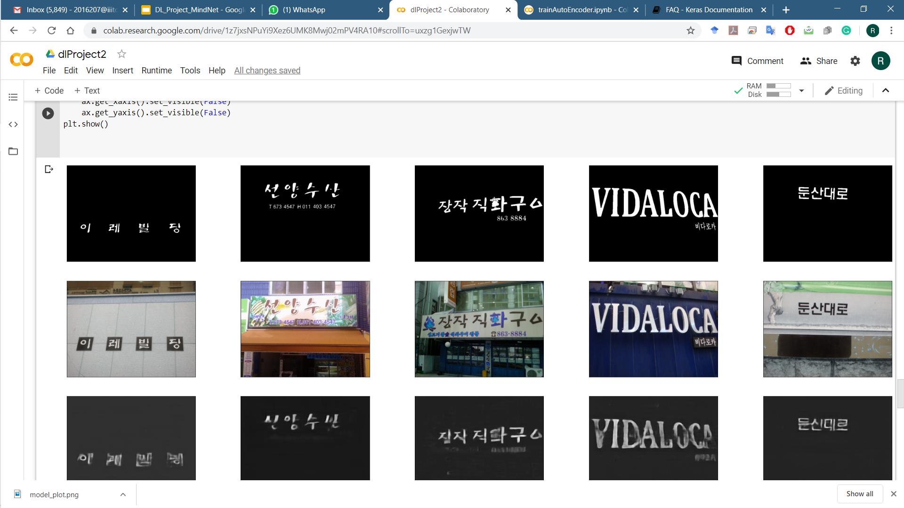
Results
After First 15 epochs

Slide 16
Thank You

